Slide 1
Artificial Intelligence

Slide 2
Lecture # 03
Problem Solving by Searching

Slide 3
Problem Solving by Search
•
An important aspect of intelligence is goal based problem solving.
The solution of many problems can be described by finding a sequence of actions that lead to a desirable goal.
Each action changes the state and the aim is
to find the sequence of actions and states that
lead from the initial (start) state to a final (goal) state.
•
•
and that
3

Slide 4
Problem Definition
A problem is defined by 5 components:
Initial state : starting point
Operator: description of an action
State space: set of all states reachable from the initial state by any sequence action
Goal test: which the agent can apply to a single state description to determine if it is a goal state
Path cost function: assign a cost to a path which is the sum of the costs of the individual actions along the path.

Slide 5
Problem Solving Agents
One kind of a goal‐based agent.
•
•
Goal based agent: considers future actions and
desirability of their outcome.
the
desirability of their outcome
•
Decides what to do by finding sequences of
that lead to desirable states.
actions
•
Intelligent agents are supposed to maximize
performance measures.
Achieving this is sometimes simplified if the
their
•
agent
can adopt a goal and aim at satisfying it.

Slide 6
Problem formulation
What are the possible states of the world relevant for solving the problem?
What information is accessible to the agent?
How can the agent progress from state to state?
Follows goal-formulation.
Courtesy: Dr. Franz J. Kurfess

Slide 7
Goal-formulation
What is the goal state?
What are important characteristics of the goal state?
How does the agent know that it has reached the goal?
Are there several possible goal states?
Are they equal or are some more preferable?
Courtesy: Dr. Franz J. Kurfess

Slide 8
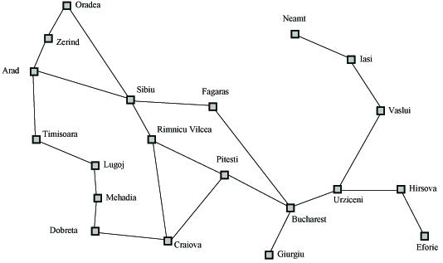
Search Example
Formulate goal: Be in Bucharest.
Formulate problem: states are cities, operators drive between pairs of cities
Find solution: Find a sequence of cities (e.g., Arad, Sibiu, Fagaras, Bucharest) that leads from the current state to a state meeting the goal condition
Fig 3.2

Slide 9
Assumptions for environment
Assumptions for the environment of agent design in figure
•
are:
•
Static : without paying attention to any changes that might
be
occuring in the environment.
Observable “knows the initial state”
•
• “knows the initial state”
•
•
Discrete : “alternative courses of action” can be enumerated
Deterministic : No unexpected events
•
All these asumptions mean that we are dealing with the
easiest kinds of environments.

Slide 10
Problem Formulation
A search problem is defined by the
Initial state (e.g., Arad)
Operators (e.g., Arad -> Zerind, Arad -> Sibiu, etc.)
Goal test (e.g., at Bucharest)
Solution cost (e.g., path cost)

Slide 11
Components of a problem formulation
State: We regard a problem as state space
here a state is a City
Initial State: the state to start from
In(Arad)
Successor Function: description of the possible actions, give state x, S(X)
returns a set of <action, successor> ordered pairs.
S(x)= { <Go(Sibiu), In(Sibiu)>, <Go(Timisoara), In(Timisoara)>,
<Go(Zerind),In(Zerind)> }
Successor Function:
Goal Test: determine a given state is a goal state.
In(Sibiu) No. In(Zerind) No.…. In(Bucharest)Yes!
Path Cost: a function that assigns a numeric cost to each path.
Path Cost:
– e.g., sum of distances, number of actions executed, etc.
–
c(x, a, y) is the step cost, assumed to be ≥ 0
Solution: a sequence of actions leading from the initial state to a goal state
{Arad ->Sibiu ->Rimnicu Vilcea ->Pitesti -> Bucharest}
S l ti

Slide 12
EXAMPLE PROBLEMS
TOY PROBLEM
•
‐Intended to illustrate or exercise various problem‐solving
methods.
‐Concise, exact description
‐Can be used to compare performance of algorithms
•
REAL‐WORLD PROBLEM
‐Whose solutions people actually care about
Whose solutions people actually care about
‐They tend not to have a single agreed upon description

Slide 13
Example Problems
toy problems
vacuum world
8-puzzle
8-queens
crypt arithmetic
vacuum agent
missionaries and cannibals
Real World problems
route finding
touring problems
traveling salesperson
VLSI layout
robot navigation
assembly sequencing
Web search

Slide 14
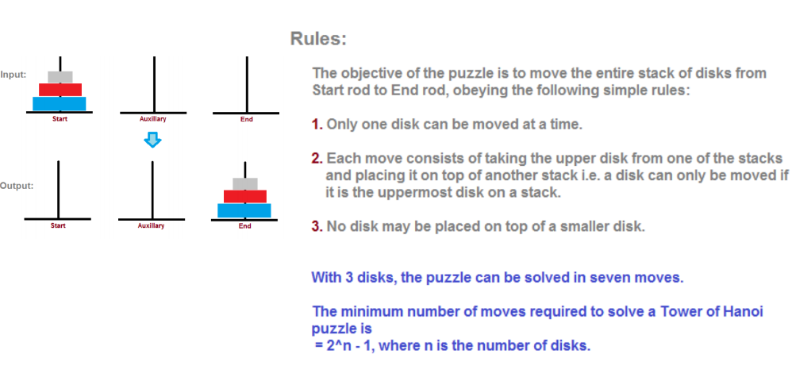
Tower of Hanoi

Slide 15
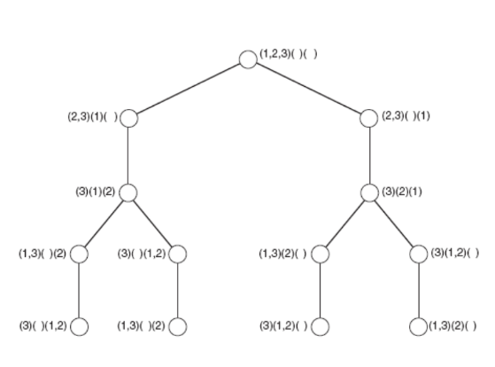
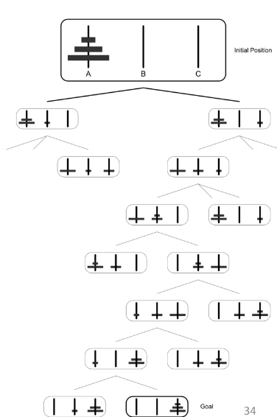
Tower of Hanoi(partial search tree)

Slide 16
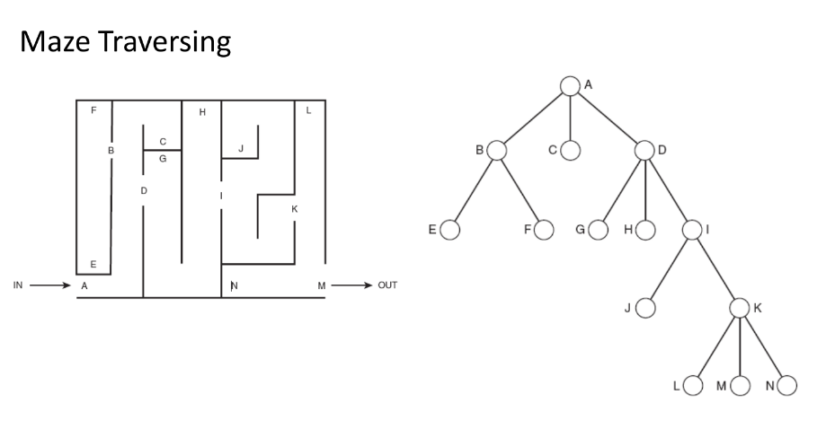
General state space search

Slide 17

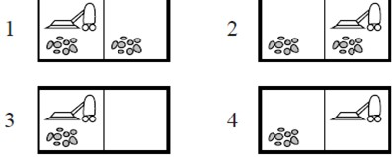
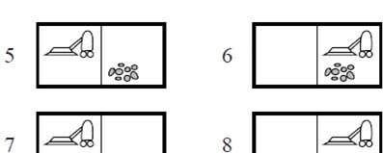
Vacuum World
‐States: location of the agent, containing dirt or not.
possible world sates.
‐Initial state: any state
I any state
‐Successor function: legal states that result from
three actions (Left,Right and Suck)
‐Goal state: checks whether all the squares are
clean.
G s checks whether all the squares are
‐Path cost: # of steps in the path (each step costs 1)

Slide 18

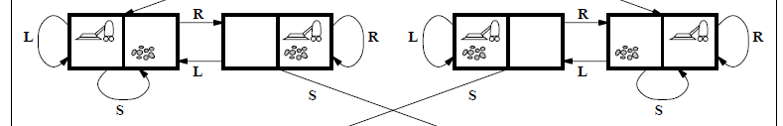

Vacuum
World
State space for the vacuum world

Slide 19


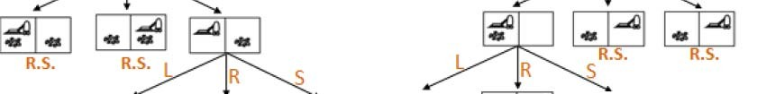

Search
Space
of
Vacuum
World
Problem:
Tree

Slide 20
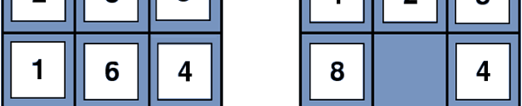
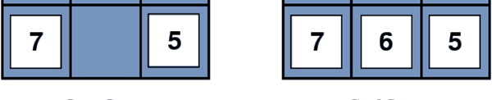
The
8‐Puzzle
An
instance
•
Consist of a
spaces.
3x3 board with 8 numbered tiles
and blank
•
•
Tile adjacent to the blank space can slide into the space.
Objective: reach a specified goal state.

Slide 21
Formulation of 8‐Puzzle
State: The location of the eight tiles, and the blank
Initial State: {(0,2), (1,8), (2,3), (3,1), (4,6), (5,4), (6,7), (_,7), (8,5)}
Successor Function: one of the four actions
(blank moves Left, Right, Up, Down).
Goal Test: determine a given state is a goal state.
Path Cost: each step costs 1
Solution: {(_,0),(1,1),(2,2) ,(3,3) ,(4,4) ,(5,5) ,(6,6) ,(7,7) ,(8,8)}
8‐puzzle belongs to the family of sliding block puzzles
This general class is known to be NP‐complete (nondeterministic
polynomial time).
9!/2=181,440 reachable states and easily solved

Slide 22

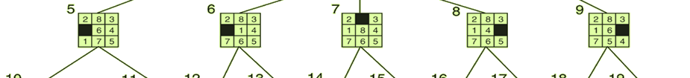
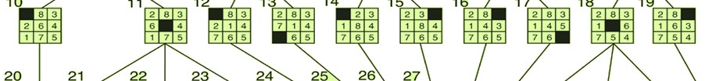
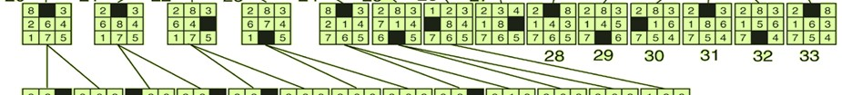
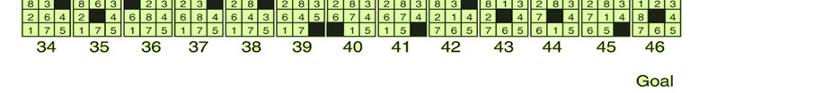
The 8‐Puzzle (State Space)
A portion of the
state space
representation of a
8‐Puzzle problem
^{© Tariq 2017} Department of Computer Science | Bahria University 34

Slide 23
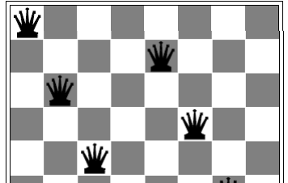


8‐Queens Problem
Place 8‐queens on a chessboard such that no queen attacks any other.
Two main kinds of formulation
1‐ Complete‐state formulation
Starts with all 8 queens on the board and moves them
around.
2‐Incremental formulation:
‐States: Any arrangement of 0 to 8 queens on the board
‐Initial state: no queens on the board
‐Successor function: Add a queen to any empty square
Add t t
‐Goal test:
8 queens are on the board, none attacked.
(
possible states to investigate.)

Slide 24
Real world problems
Some of the real world problems
are,
•
•
•
•
•
•
•
•
Route finding problem
Touring problems
Travelling salesperson problem
VLSI layout problem
Robot navigation
Automatic assembly
Drug Design
Protein Design
sequencing
•
Internet searching

Slide 25


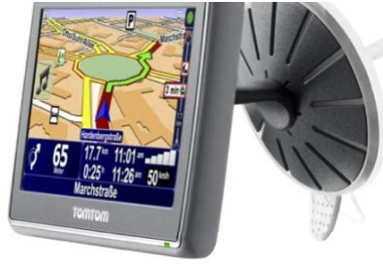
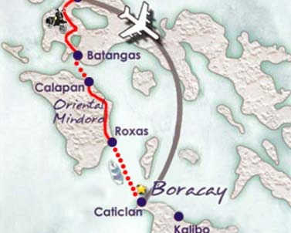
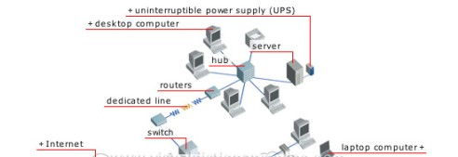
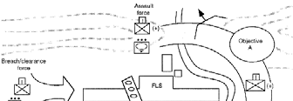
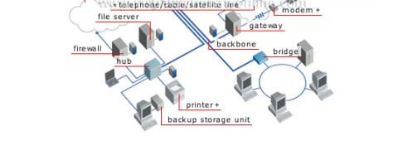
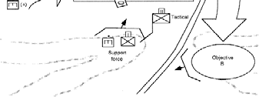
Route finding
problem
•
States
–
locations
l ti
•
Initial state
–
starting point
•
Successor function (operators)
–
move from one location to another
Car Navigation
Airline travel
planning
•
Goal test
–
arrive at a certain location
•
Path cost
–
may be quite complex
• money, time, travel comfort, scenery,
b it l
Routing in Computer
networks
Military operation
planning
Milit ti

Slide 26

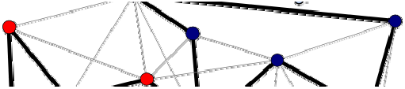
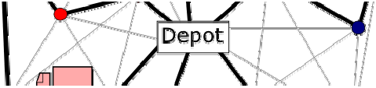
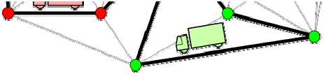
Routing
Finding
Problem
What is
A set of
the state space for each of them?
places with links between them, which have been
visited

Slide 27

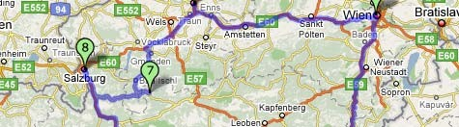
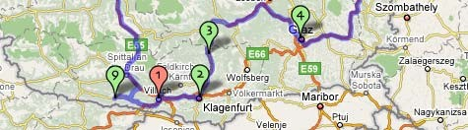
Travel Salesperson
Problem
•
States
–
locations / cities
–
illegal states
• each city may be visited only once
• visited cities must be kept as state information

Slide 28
Travel Salesperson
Problem
•
States
–
locations / cities
–
illegal states
• each city may be visited only once
• visited cities must be kept as state information
•
Initial state
–
–
starting point
no cities visited
•
Successor function (operators)
–
move from one location to another one
•
Goal test
–
–
all locations visited
agent at the initial location
•
Path cost
–
distance between locations

Slide 29

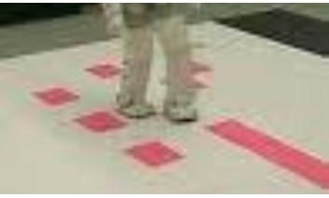

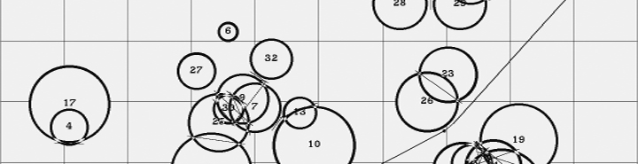
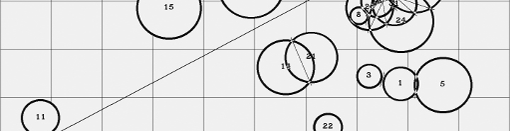
Robot
Navigation
•
States
–
–
locations
position of actuators
•
Initial state
Initial state
–
start position (dependent on the task)
•
Successor function (operators)
–
movement, actions of actuators
•
Goal test
–
task‐dependent
•
Path cost
–
maybe very complex
• distance, energy consumption

